Slide 1
Skywave:
An Exploration of the Enchanting Impacts of Cosmic Cybernetics
Sarah Hontoy-Major, Jennifer Brown

Slide 2
An Exploration of the Enchanting Impacts of Cosmic Cybernetics
Skywave:
Accurate results not a priority / speculative
We’re looking for magic / Enhanced through tech (David Rose 2014)
In relation to the Universe’s order, nature, patterns, …
Communication between systems (humans and radio)

Slide 3
Keywords
Cosmic Cybernetics
Electromagnetism
Technopaganism
Skywave
System of cybernetics including both active participants and their environment on a cosmic scale
Subcategory of Paganism encompassing technology intrinsically within their religious practice and experience
The shared language of electromagnetic frequency and its medium; wielded by humans via radio

Slide 4
Research Questions
I.
II.
III.
How can enchantment be created or amplified by inferring
natural (analog) modes of communication?
How can both mechanical and human processes be informed by communicating across common channels?
What can be
inferred from cosmic phenomena by exploring their impact upon human and mechanical systems?

Slide 5
To Summarize:
Skywave explores the invisible impacts of cosmic interaction upon both machines and humans. Culminating as a proposed ritual between human and non-human participants, electromagnetic waves and machine learning are utilized to explore underlying systems of communication between humans, machines, and the natural world.

Slide 6
Project Overview
Goals
Synchronizing invisible* methods of communication between human and radio participants in a system of cosmic cybernetics
Express this as a ritual in which data is meaningfully shared
Determine a mode of communication which allows for the encoding and decoding of this data
Research and contribute to research
* Invisible to humans

Slide 7
Theory
Technopaganism
Glitch Feminism*
Making Kin with the Machines**
Non-institutional spiritual practice
Technology as natural, spiritual
Decentering the human perspective
Values diversity of belief
Ritual practices (group or solo; local or remote)
Emphasizing ‘glitch’ as moments of enchantment revealing uniqueness
Liberation through the dissolution of traditional boundaries enabled through technology
“Man is neither height nor centre of creation”
Explores the affordances that mutual relationships could have on the ways we approach the development of AI
* Manifesto by Legacy Russell
** Essay by Jason Lewis, Noelani Arista, Archer Pechawis, and Suzanne Kite

Slide 8
Methodology: Radio
Radio: a signal at the mid-low end of the electromagnetic spectrum produced by all animate and inanimate objects, and the Universe itself.
Electromagnetic fields are all around us, produced naturally and of cosmic origins; interacting with their surroundings
These signals can be wielded and decoded with the use of radio electronics in collaboration with human operators and protocol writers
Our project explores this phenomena in an enchanted setting, inspired by witchcraft and technopaganism.
Digital Signal Processing allows tons of formats to be sent
PSK-31 (Phase Shift Keying, 31 baud) is a keyboard-to-keyboard digital mode that allows communication through text via radio signal.

Slide 9
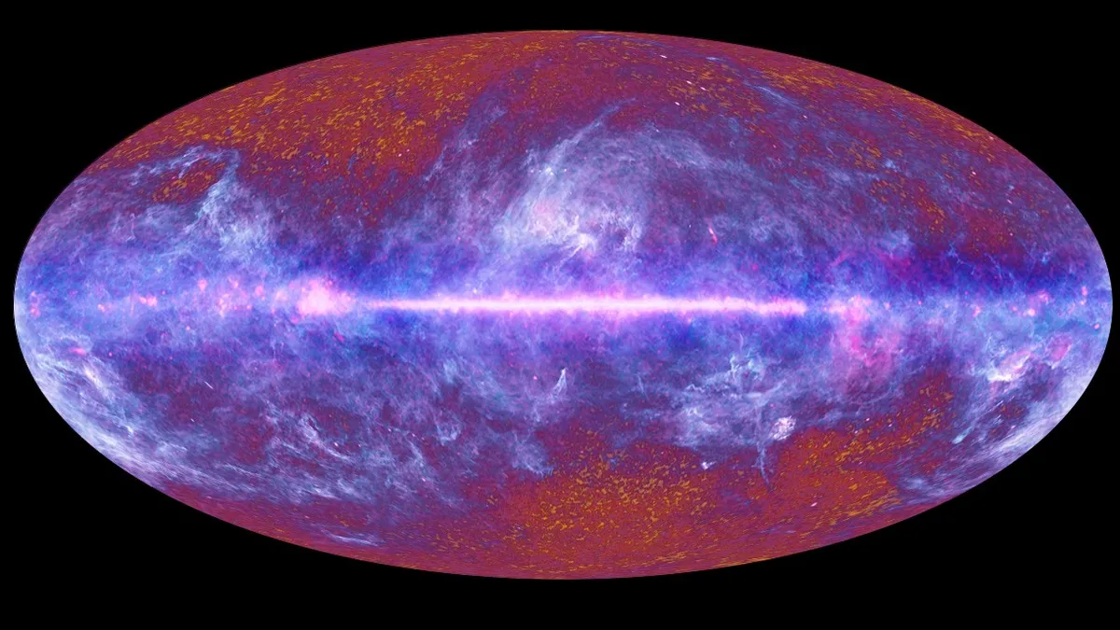
Methodology: Micro/macro scales
Assisted by technology, electromagnetic waves allow us to interact on micro/macro scales.
We can interact directly with cosmic agents like earth’s ionosphere and moon in signal propagation
Using Cosmic Microwave Background Radiation, we can infer information about the history of the Universe.
… And what else?
This all-sky image of the cosmic microwave background, created from data collected by the European Space Agency's Planck satellite’s first all-sky survey, shows echoes of the Big Bang left over from the dawn of the universe. (Image credit: ESA/ LFI & HFI Consortia) From space.com article, 2022

Slide 10
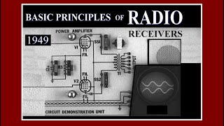
Methodology: Radio Anatomy
An antenna receives many frequencies
The tuner reduces information to only the variably attuned frequency
This signal is twofold: one low frequency carrier, one high frequency message
This incoming signal is amplified, and passed to a local crystal oscillator with a unique attuned frequency to produce an intermediate frequency (IF)
The low carrier frequency is split from the signal and redirected
The high, data-rich frequency is routed to the amplifier and output audibly

Slide 11


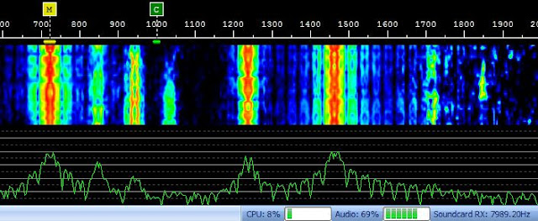
Methodology: Communication Modes
PSK-31 (Phase Shift Keying, 31 baud) is a keyboard-to-keyboard digital mode that allows communication through text via radio signal.
Works under poor conditions and transmits at an average typing speed.
Waterfall Displays: X = frequency domain/span; Y = different data sweep with time; Z = spectrogram (heat map) with a real-time spectrum analyzer (at the bottom, frequency in x, amplitude in y)
Binary PSK-31 sample on SigidWiki
Waterfall display of digital mode from hamprojects.blogpost.com (2013)

Slide 12
Methodology
Data Input
Biometric data is gathered from the Emotibit, mapped to an emotion in ML (but expressed as a frequency), transmitted to TouchDesigner over OSC
Radio data is transmitted to TouchDesigner over serial
Proposed Output
Both incoming frequencies combine via unsupervised ML to produce correlated audio/visual effects (language!) within TouchDesigner
The output should be decryptable, able to reveal the input frequencies.
* Invisible to humans

Slide 13
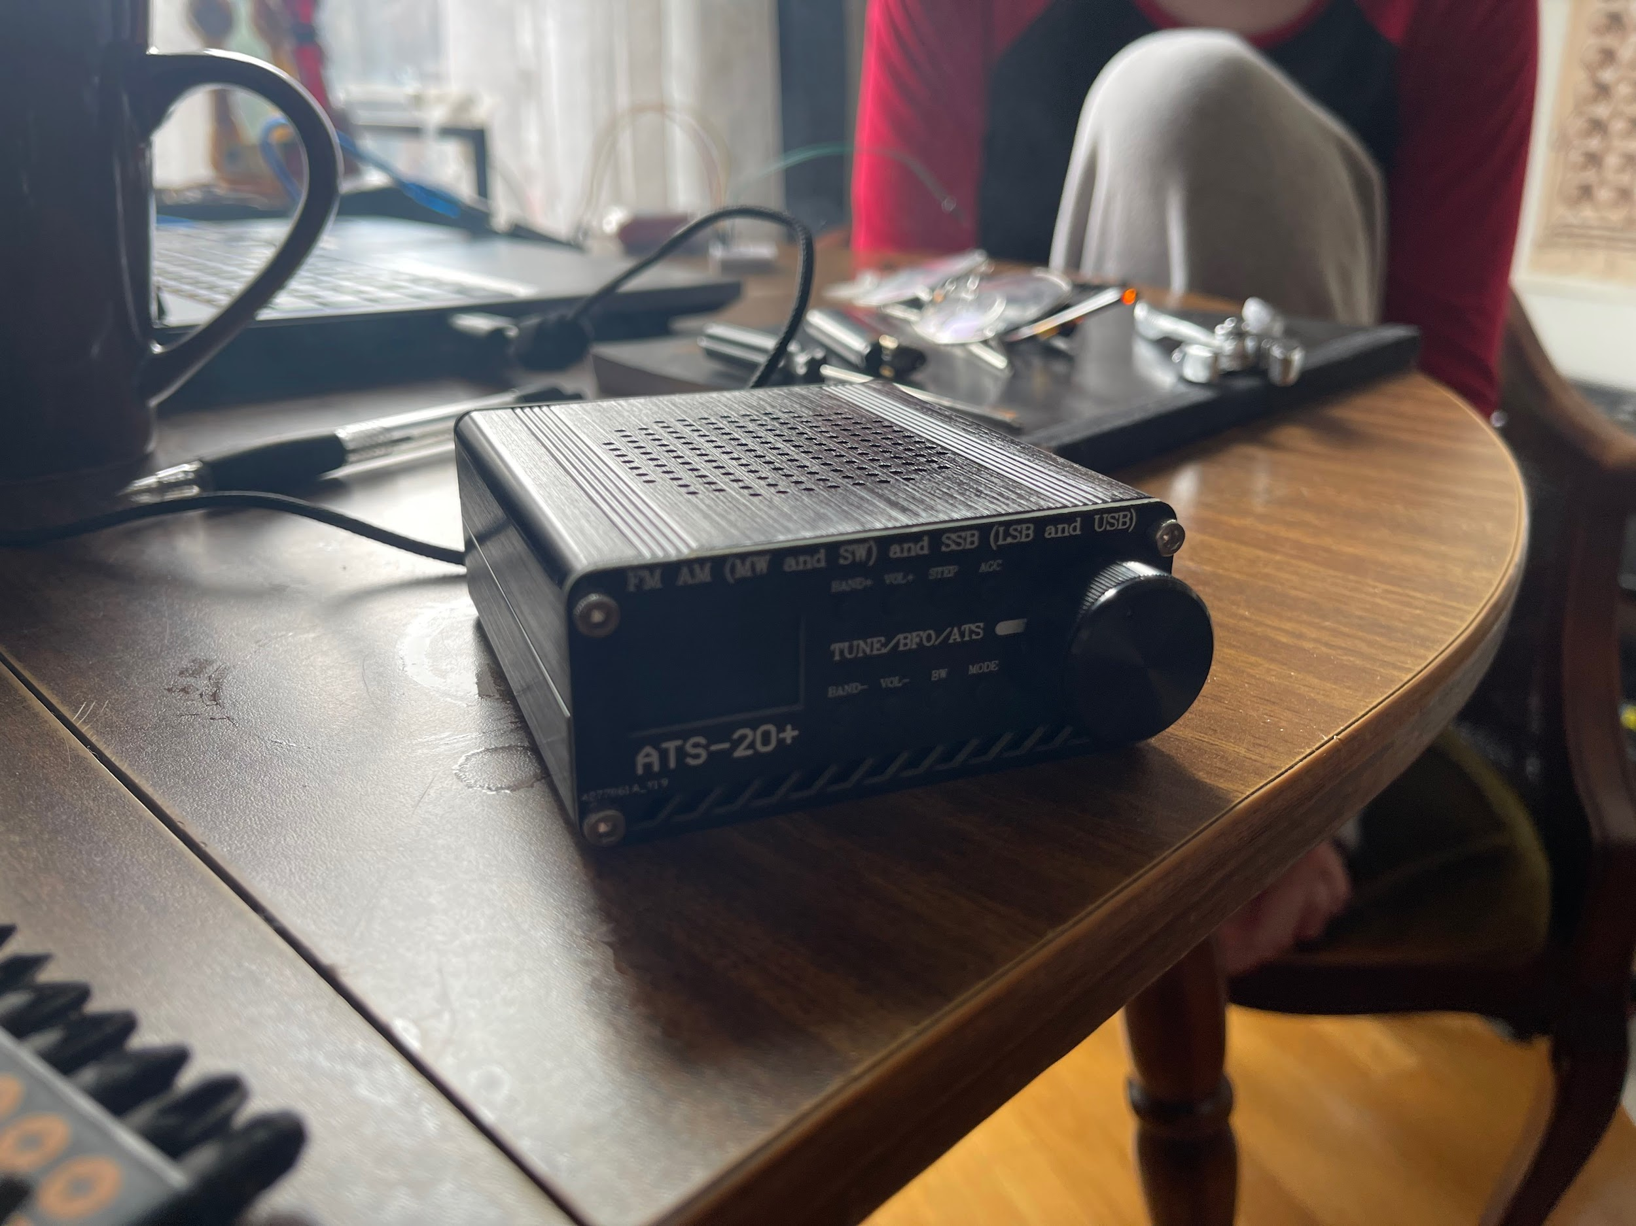
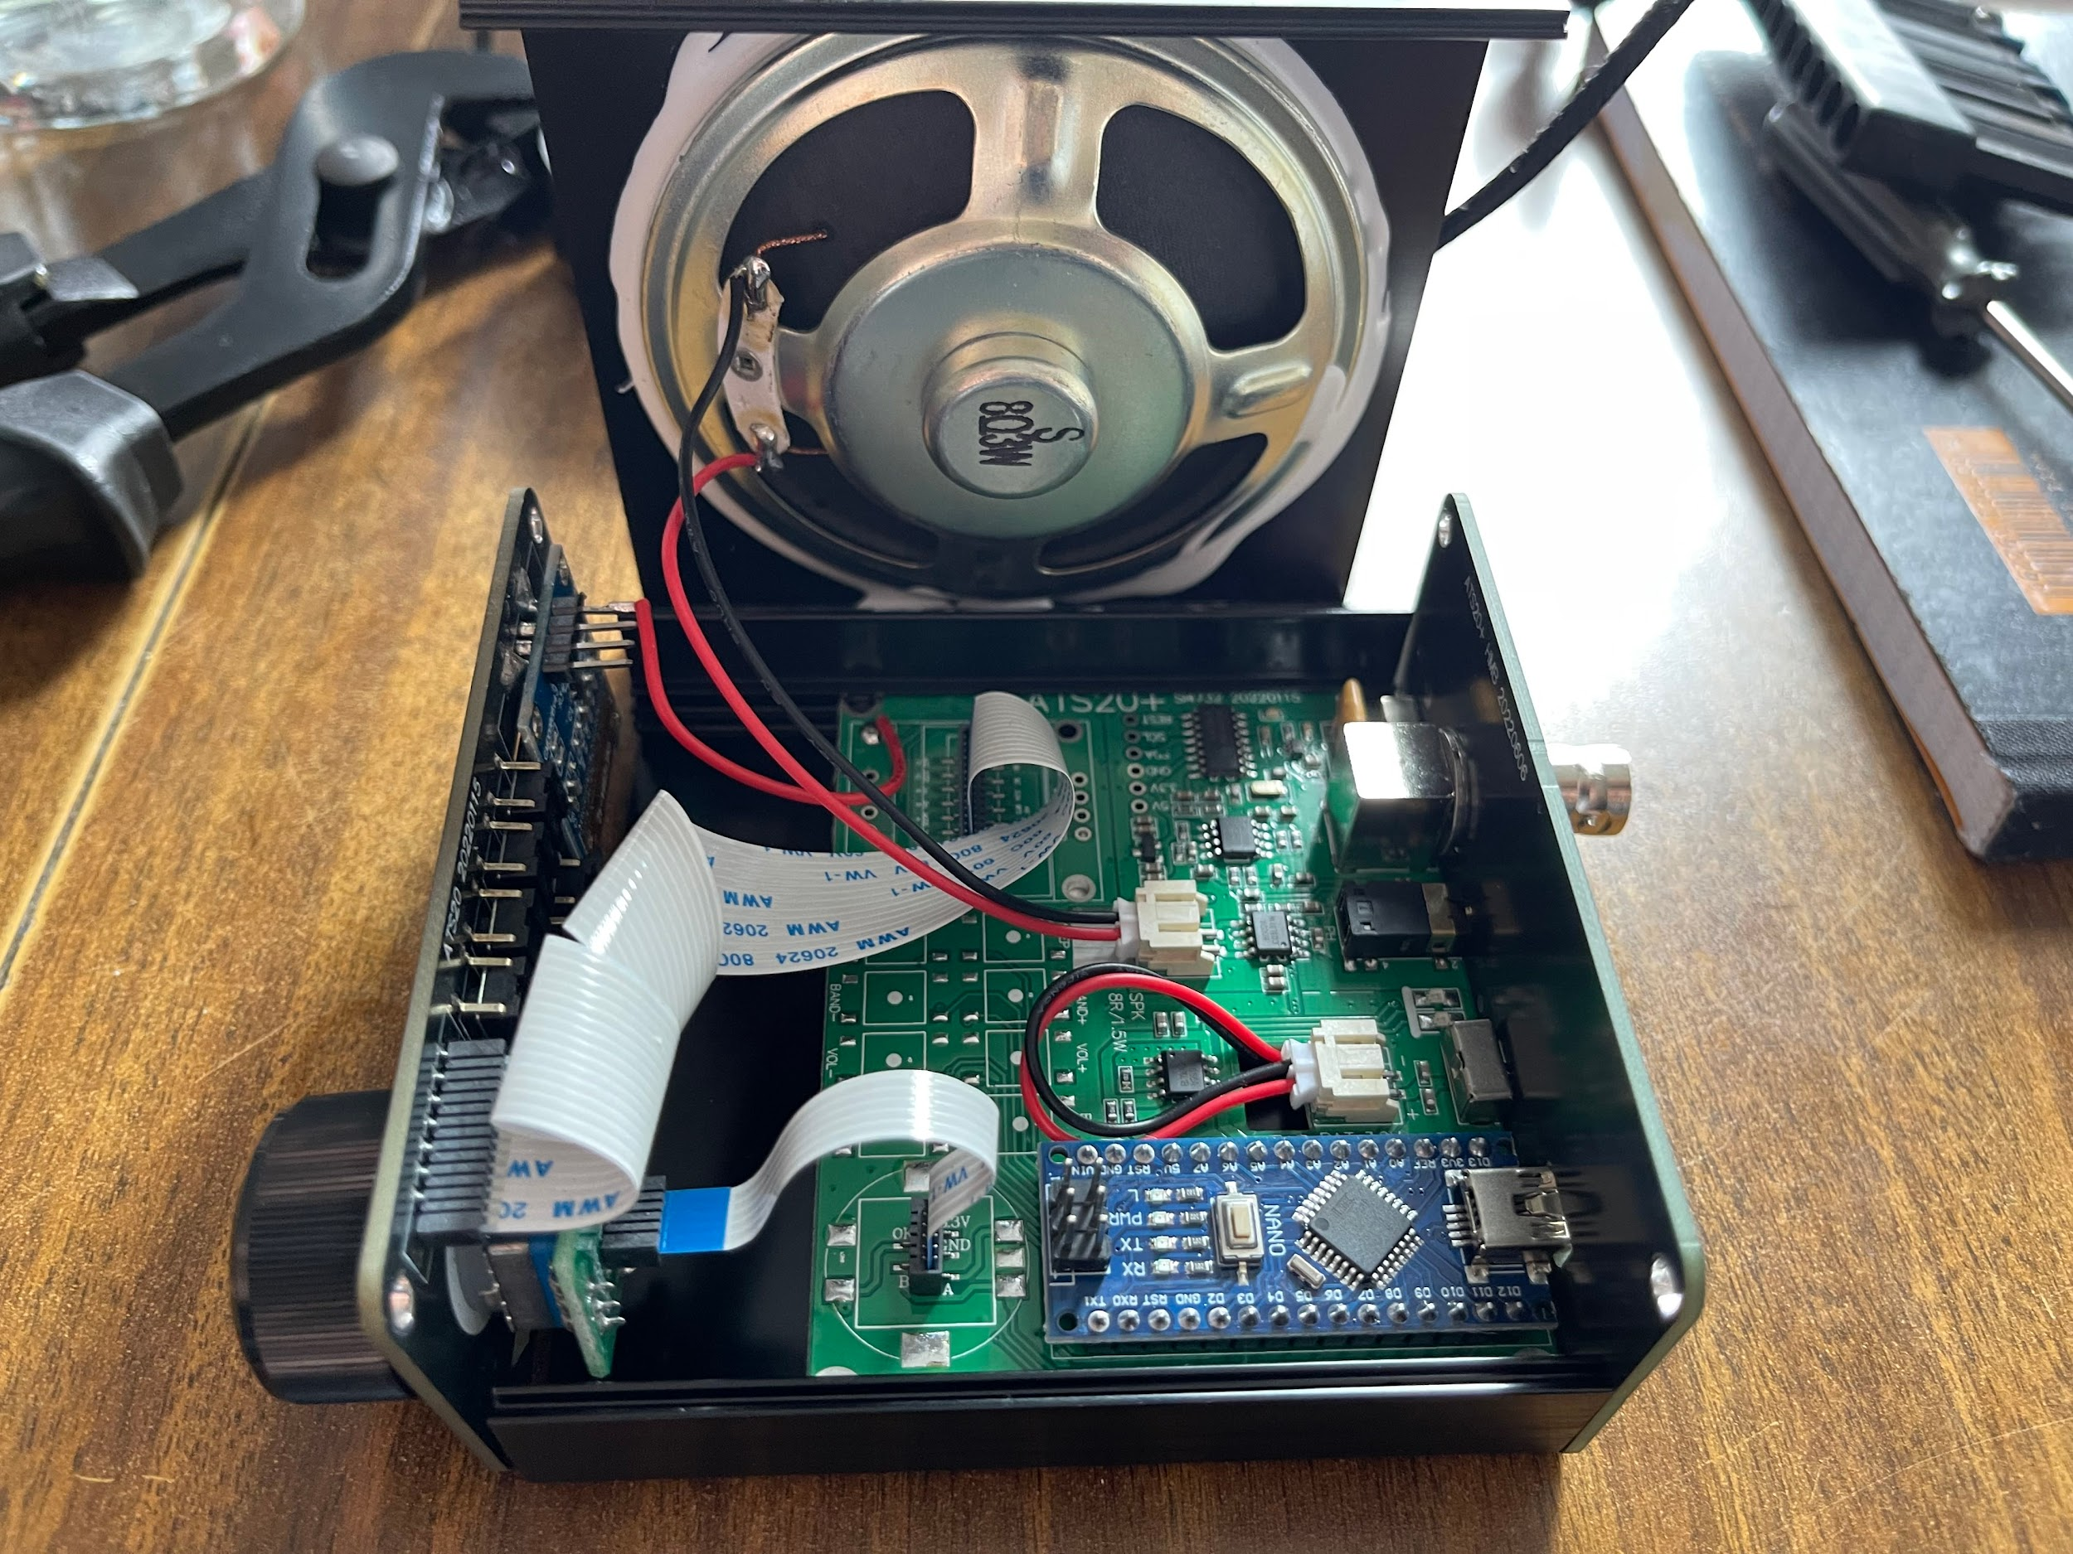
Hardware: Tina Tuner
ATS-20 all band radio receiver, Tina Tuner!
Operates from an (bootleg) Si4732 radio chip and (bootleg) Arduino Nano
She contains an audio output jack and bidirectional USB, as well as controls for bandwidth, frequency, mode and automatic gain control - and an antenna

Slide 14
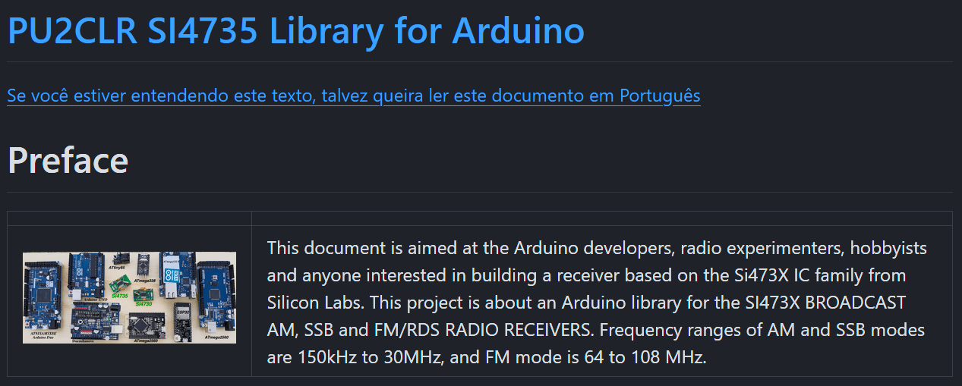
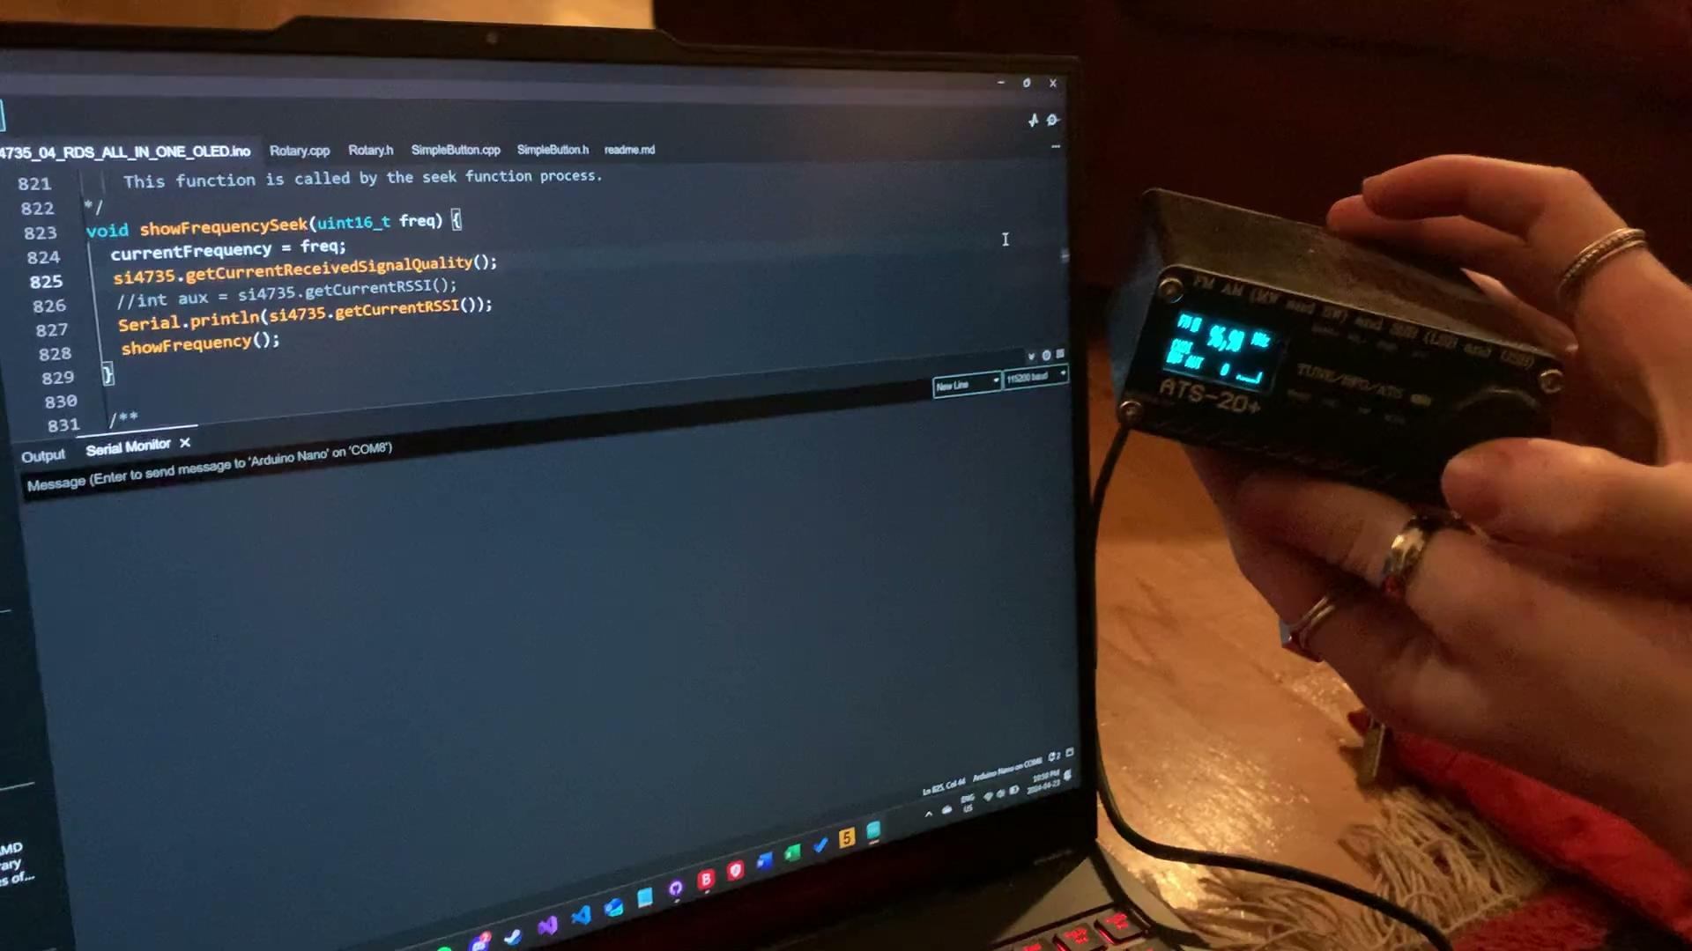
Software: Tina Tuner
PU2CLR Arduino Library
Firmware update, adding additional functionality
Serial Port Communication
Reading data, writing to prompt action
Requires a wired connection
Can be accessed from various platforms, eg Arduino IDE, TouchDesigner (but only one at a time).
Restricted by the Nano storage: base library occupies 96% of storage

Slide 15
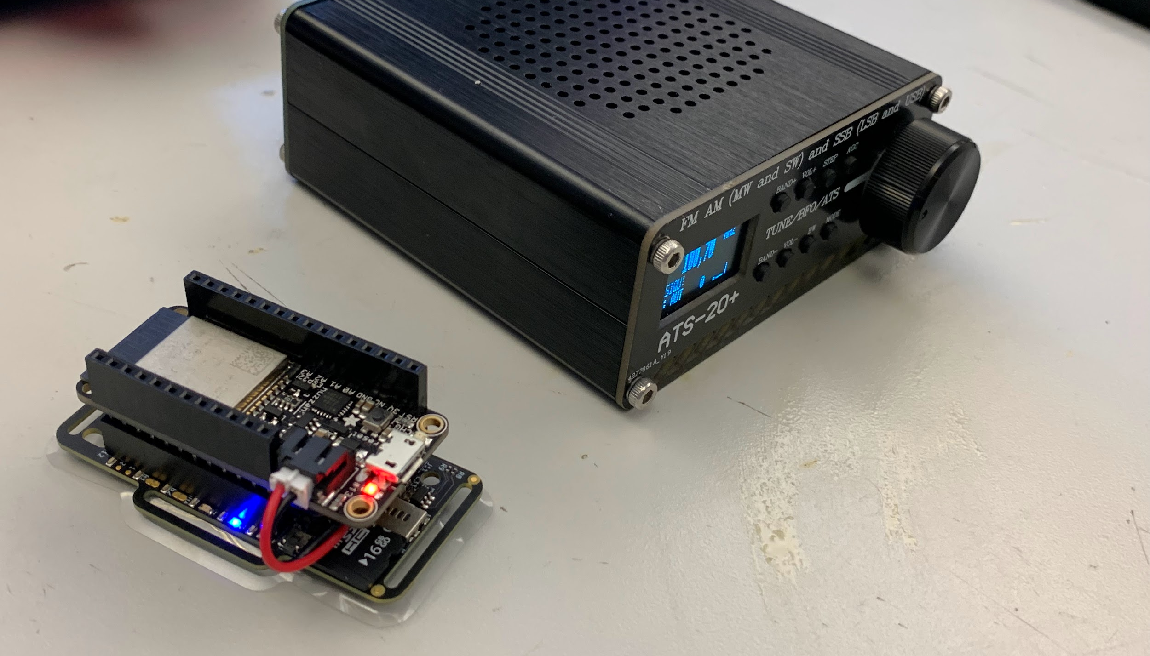
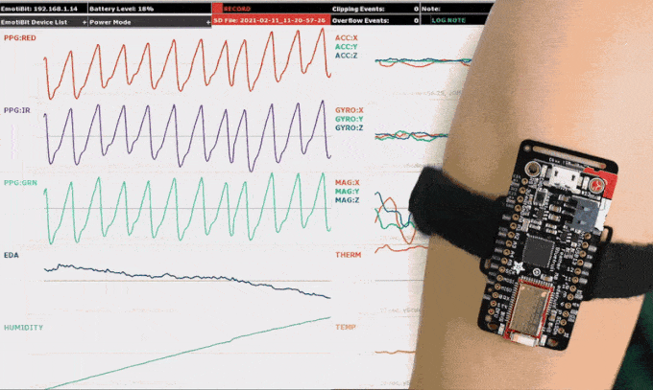
Hardware: Eva
Emotibit Eva!
Collects biometric data when worn by a human
This can be mapped to indicate wearer’s emotion using ML
Data is primarily generated by emitting and receiving light through the skin to reveal underlying anatomic processes
E.g., temperature, heart rate, skin galvanic response, etc.

Slide 16
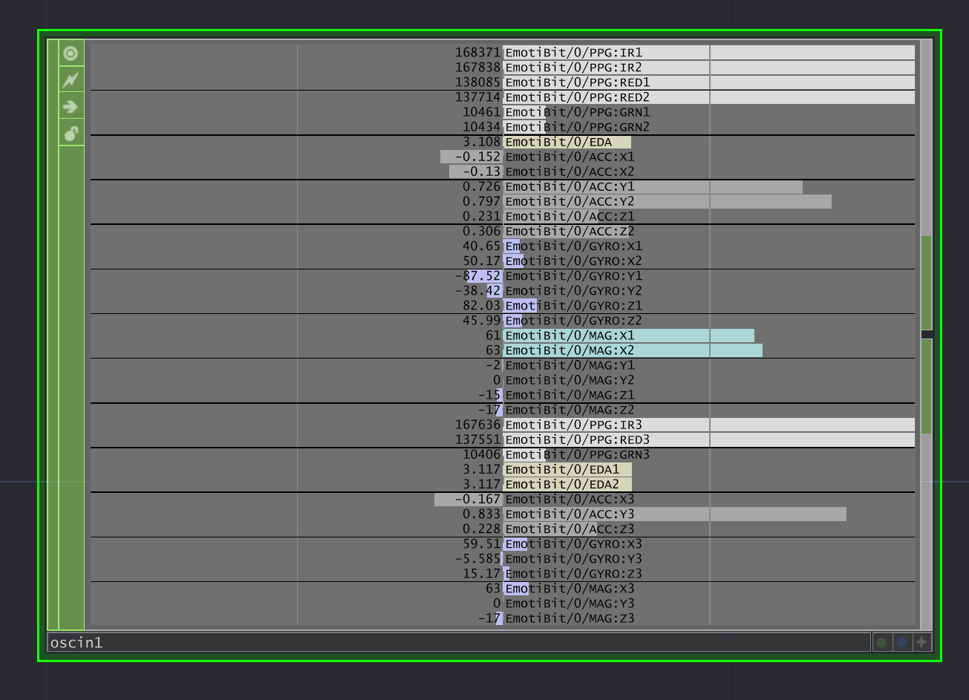
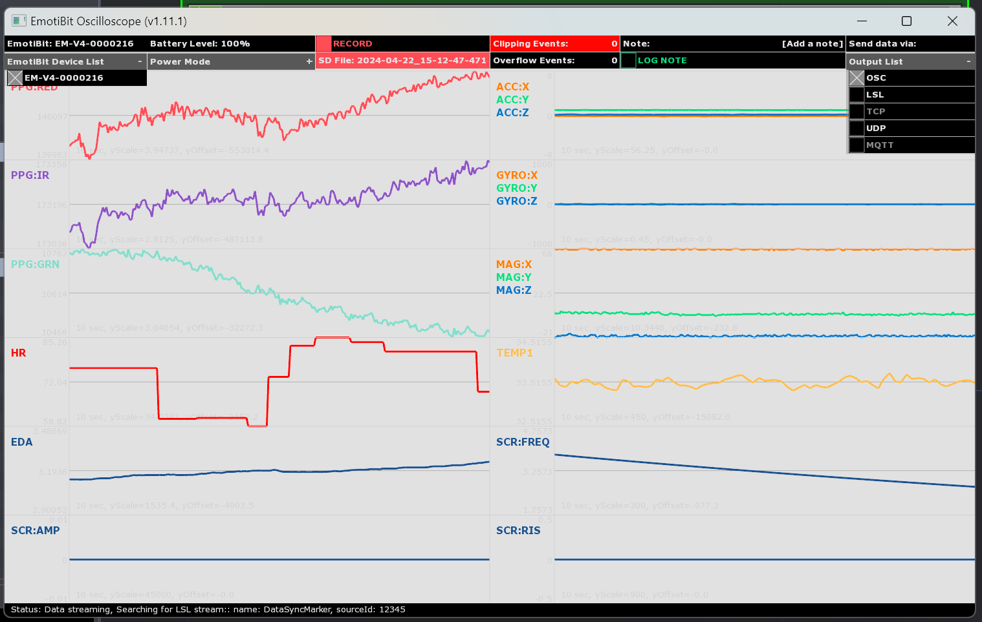
Software: Eva
Collected data may be stored on an internal micro-SD, and/or transmitted over wifi.
When transmitting wirelessly, the data may be received by Emotibit’s Oscilloscope and parsed into features
These can be retransmitted over OSC, but transmit with multiple unique message prefixes.
To transmit the features with a single message prefix (for Wekinator receiving) we utilize the Emotibit ML library (thanks Thomas!)

Slide 17
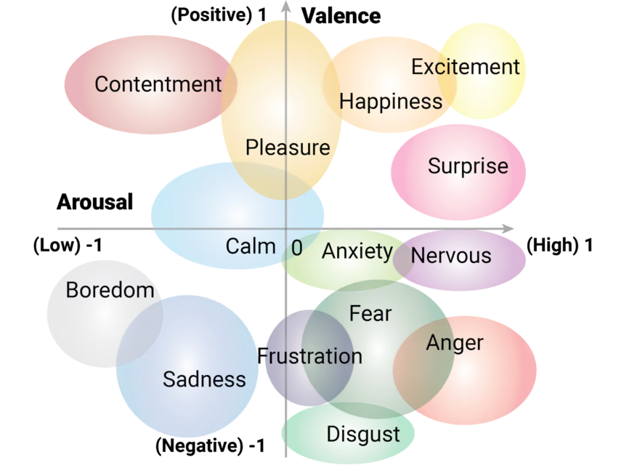
Seeking Ritual
From Emotibit’s website
Eva translates somatic information (PPG, temperature, heart-rate and skin conductance) from the human to the main board;
A supervised model classifies the human’s emotion on an arousal/valence scale, informing the output of an integer representative of frequency
Tina seeks radio frequency she deems good enough for us to listen to (sometimes she seems to fall short)
If the human stays attuned to the radio’s frequency, the data of the spectrograph from the ambient ritual is sent to Skywave.

Slide 18
More-Than-Human Language Model
Once defined, the human and radio participant’s frequencies are sent to the model to be mapped as a common frequency, their own and theirs only. This is their kinned position on the frequency spectrum.
We hope to extrapolate communication patterns from the spectrograph output with our own speculative DSP (digital signal processing)
Aiming to prioritize the agency of both participants: unsupervised regression model
We are still conflicted on the training set we would like to use, as it is the basis of our speculative communication mode.

Slide 19
Future Work
Radio
Data
Proper equipment
Transmission (& license)
Exploring local oscillation
Training and refining an ML model
Studying output and determining significance
Archiving and publishing data
Ritual
Frequencies
Multiple participants… maybe remote?
Moonbouncing & signal propagation
Using EEG technologies to trace human frequencies
Other inanimate objects’ frequencies

Slide 20
Thank you

Slide 21
References
It’s all us. We invented everything.

Slide 22
References
Abraham, Amelia. “Breaking Open the Machine with Legacy Russell’s Glitch Feminism.” ELEPHANT, September 2, 2020. https://elephant.art/breaking-open-the-machine-with-legacy-russell-glitch-feminism-02092020/.
Computer History Archives Project (“CHAP”). Radio Electronics History: Radio Receivers 1949 Antennas, Superhet, Vacuum Tubes, 2022. https://www.youtube.com/watch?v=XOdqGDgte4M.
Davis, Erik. Techgnosis: Myth, Magic, Mysticism in the Age of Information. 1st ed. New York: Harmony Books, 1998.
Dos Santos, Victoria. “(Techno)Paganism: An Exploration of Animistic Relations with the Digital.” Religions 14, no. 11 (November 3, 2023): 1382. https://doi.org/10.3390/rel14111382.
Downey, Jow, Tim O’Shea, and Nathan West. “In the Future, AIs—Not Humans—Will Design Our Wireless Signals.” IEEE Spectrum, April 23, 2020. https://spectrum.ieee.org/in-the-future-aisnot-humanswill-design-our-wireless-signals.
Harris, Mark. “Inside the First Church of Artificial Intelligence | Backchannel.” Wired, November 15, 2018. https://www.wired.com/story/anthony-levandowski-artificial-intelligence-religion/.
Hayles, N. Katherine. Unthought: The Power of the Cognitive Nonconscious. Chicago, IL: University of Chicago Press, 2017. https://press.uchicago.edu/ucp/books/book/chicago/U/bo25861765.html.
Kaufman, Mark. “Radio Signals Keep Coming from Deep Space. Here’s What They Really Are.” Mashable, April 4, 2023. https://mashable.com/article/radio-waves-space-not-aliens.
Lewis, Jason Edward, Noelani Arista, Archer Pechawis, and Suzanne Kite. “Making Kin with the Machines.” Journal of Design and Science, July 16, 2018. https://doi.org/10.21428/bfafd97b.
Magee, Tamlin. “A Cult That Worships Superintelligent AI Is Looking For Big Tech Donors.” Vice (blog), March 21, 2023. https://www.vice.com/en/article/z3meny/artificial-intelligence-cult-tech-chatgpt.
McArthur, Neil. “Gods in the Machine? The Rise of Artificial Intelligence May Result in New Religions.” The Conversation, March 15, 2023. http://theconversation.com/gods-in-the-machine-the-rise-of-artificial-intelligence-may-result-in-new-religions-201068.
Mohon, Lee. “Cosmic Harmonies: Sonifications From NASA Telescopes - NASA,” June 20, 2023. https://www.nasa.gov/missions/chandra/cosmic-harmonies-sonifications-from-nasa-telescopes/.
O’Leary, Stephen D. “Cyberspace as Sacred Space: Communicating Religion on Computer Networks.” Journal of the American Academy of Religion 64, no. 4 (1996): 781–808.
Photon. “The Harmonious Universe: Understanding How Everything Is Made up of Frequencies.” Medium (blog), February 24, 2023. https://photonnow.medium.com/the-harmonious-universe-understanding-how-everything-is-made-up-of-frequencies-c77e80188dd9.
Poole, Ian. “Radio Waves and the Ionosphere.” Nature 154, no. 3909 (1944): 413–413. https://doi.org/10.1038/154413a0.
“Radio Waves,” 2010. https://science.nasa.gov/ems/05_radiowaves/.
Schröder, Frank G. Instruments and Methods for the Radio Detection of High Energy Cosmic Rays. Springer Theses. Berlin, Heidelberg: Springer Berlin Heidelberg, 2012. https://doi.org/10.1007/978-3-642-33660-7.
SEA. The Afterglow of the Big Bang: The Cosmic Microwave Background, 2021. https://www.youtube.com/watch?v=UNDzaIaSNj8.
Thibodeau, Zeph, and Chronogenica Members. “CHRONOGENICA – BECOMING TOGETHER.” Accessed March 25, 2024. https://chronogenica.ca/.
Vickers, Ben, and Kenric McDowell, eds. Atlas of Anomalous AI. UK: Ignota Books, 2020.

